Slide 1

Dart Data types and variables

Slide 2
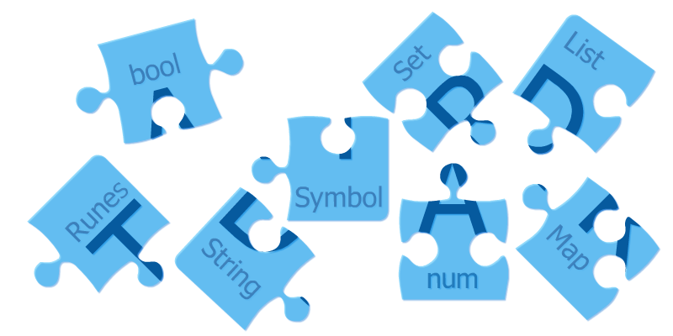
Dart Data Types
The data types are the most important fundamental features of programing language. In Dart, the data type of the variable is defined by its value. The variables are used to store values and reserve the memory location. The data-type specifies what type of value will be stored by the variable. Each variable has its data-type. The Dart is a static type of language, which means that the variables cannot modify.

Slide 3
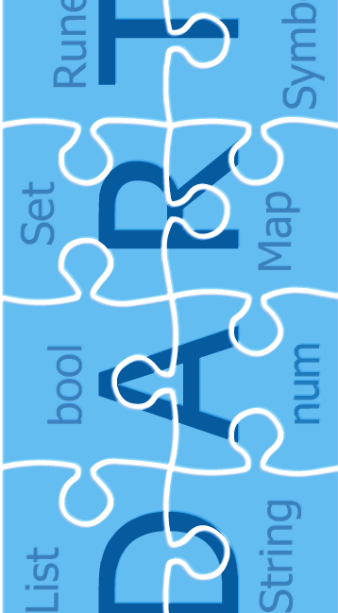
Dart supports the following built-in Data types :
Number
Strings
Boolean
Lists
Maps
Runes
Symbols

Slide 4
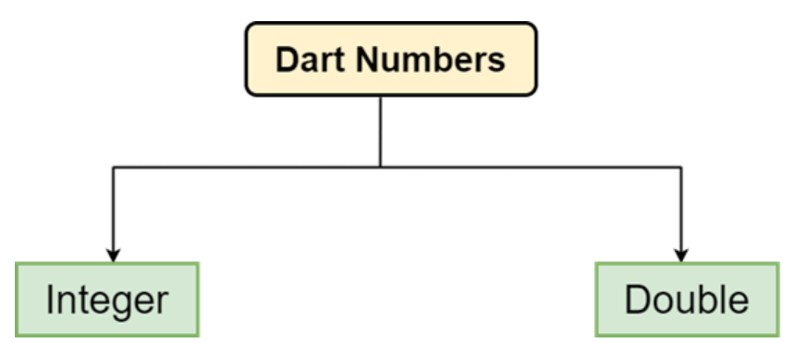
Dart Number
The Number is the data type that is used to hold the numeric value. In Dart, It can be two types Integer, Double.

Slide 5

Dart integer
Integer numbers are the whole numbers means that can be written without a fractional component. For example - 20, 30, -3215, 0, etc. An integer number can be signed or unsigned.
The int keyword is used to declare integer value in Dart.

Slide 6
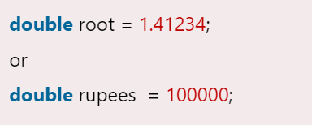
Dart Double
The Double number are the numbers that can be written with floating-point numbers or number with larger decimal points.
The double keyword is used to declare Double value in Dart.

Slide 7
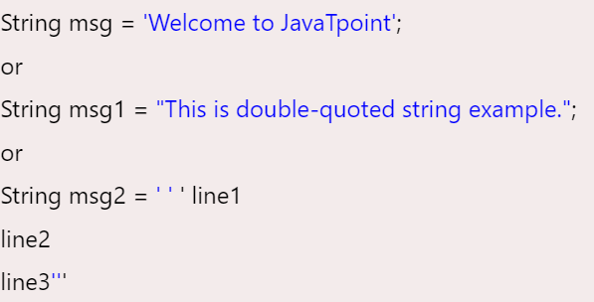
Dart String
Dart String is a sequence of the character or UTF-16 code units. It is used to store the text value. The string can be created using single quotes or double-quotes. The multiline string can be created using the triple-quotes. Strings are immutable; it means you cannot modify it after creation.
In Dart, The String keyword can be used to declare the string. The syntax of the string declaration is given below.

Slide 8
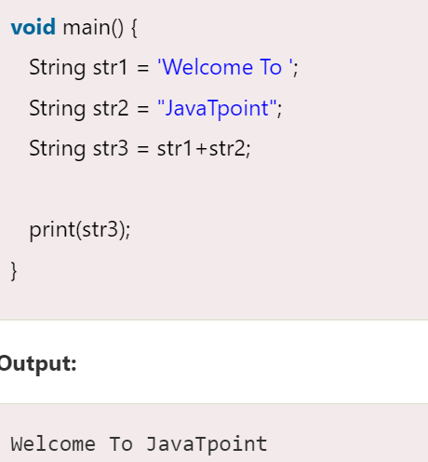
String Concatenation
The + or += operator is used to merge the two string. The example is given below.

Slide 9
String Interpolation
String interpolation in Dart allows you to embed expressions within strings to construct dynamic strings more easily.
It's a way to insert the value of Dart expressions inside string literals.
This feature makes code more readable and concise compared to traditional
concatenation methods.
In Dart, you can use string interpolation by placing the expression within curly braces {} inside a string literal.
Let's understand by the following example in next slide.

Slide 10
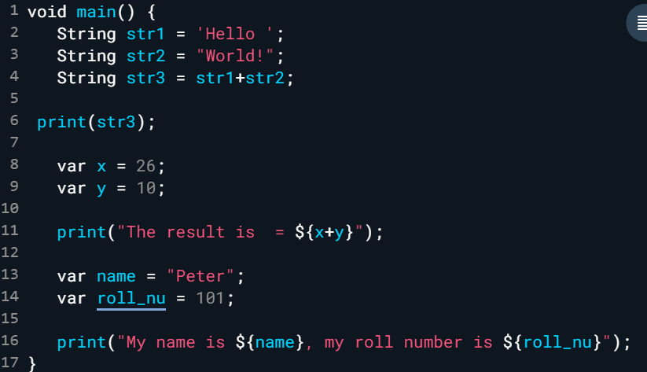

String Interpolation(example)

Slide 11
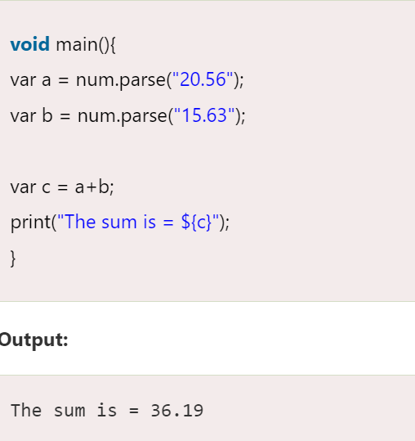
Dart parse() function
The parse() function converts the numeric string to the number. Consider the following example :

Slide 12
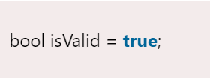
Dart Boolean
The Boolean type represents the two values - true and false. The bool keyword uses to denote Boolean Type. The numeric values 1 and 0 cannot be used to represent the true or false value.

